Slide 1


2020
Netcoreconf
Azure Durable Functions: Detrás de la magia
Juan Carlos Martinez
Luis Mañez
18/01/2020
Technical architect “Mr. Connect” (ClearPeople LTD)
Cloud Solutions Architect (ClearPeople LTD)
@jcmartinezg23
@luismanez

Slide 2
Sponsors

Slide 3

What are
“Azure Durable Functions”?

Slide 4
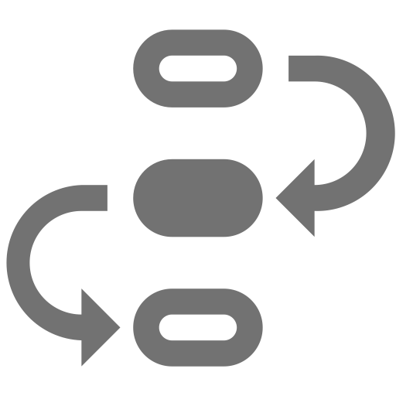


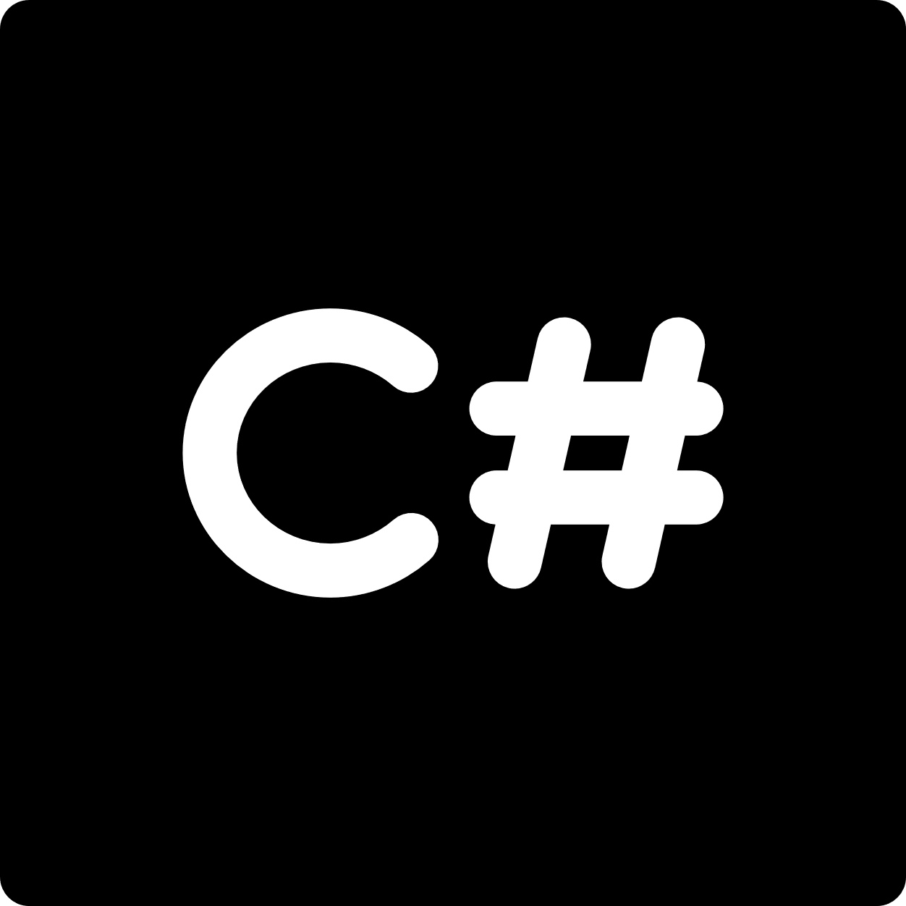

stateful functions in
serverless environment
workflow in code
azure functions extension
languages
F#

Slide 5
Event Sourcing

Slide 6
What it is Event Sourcing
Design pattern that specifies a way of storing app state
This app state is composed by a conjunction of events
EVERY change on the state is stored sequentially
Allows us to recreate or query app state at any given time

Slide 7
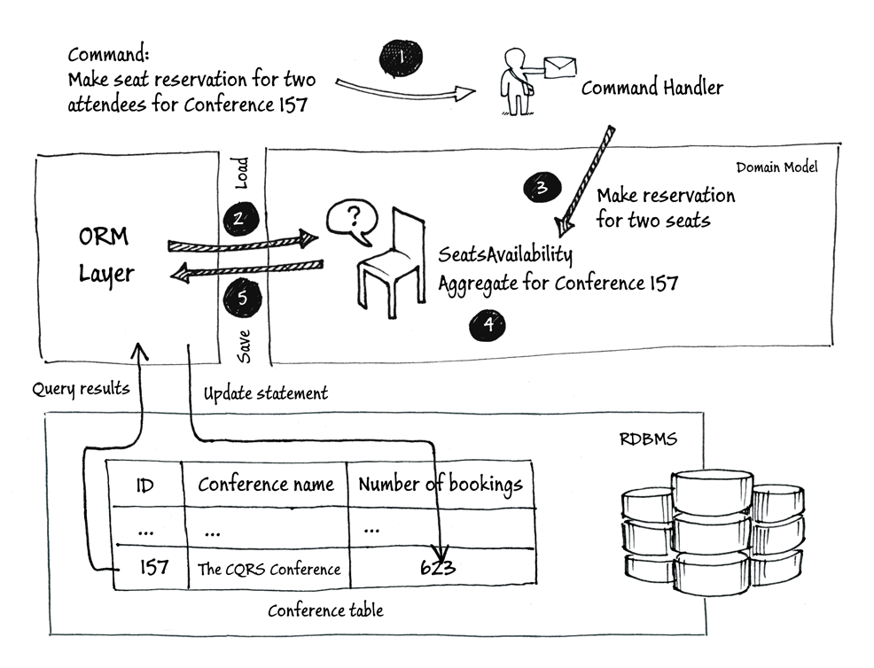
ORM Approach

Slide 8
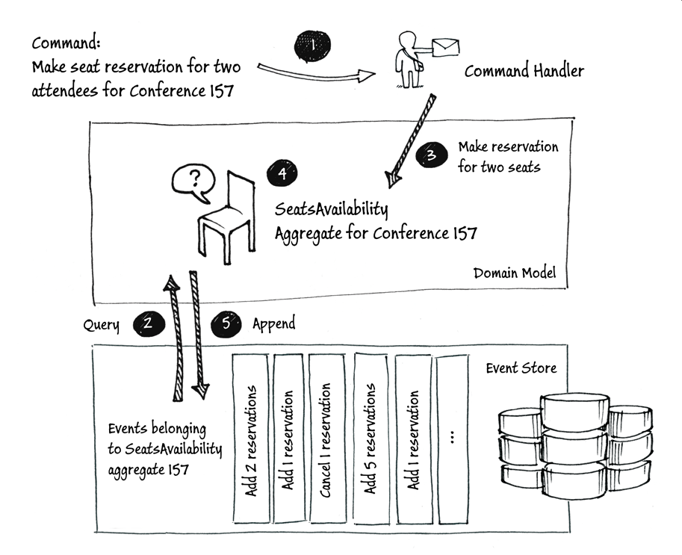
Event Sourcing Approach

Slide 9
How it works within Durable Functions
Azure Storage tables act as the storage system
One row per status change
Columns to store inputs, outputs and additional details
Framework uses the events stored in the table to rebuild the orchestrator state

Slide 10
Durable Functions Application Patterns

Slide 11
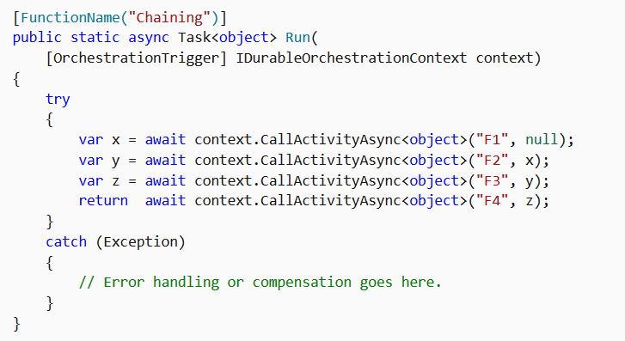
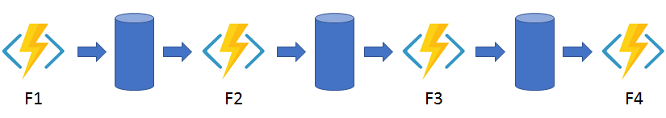
Function chaining

Slide 12
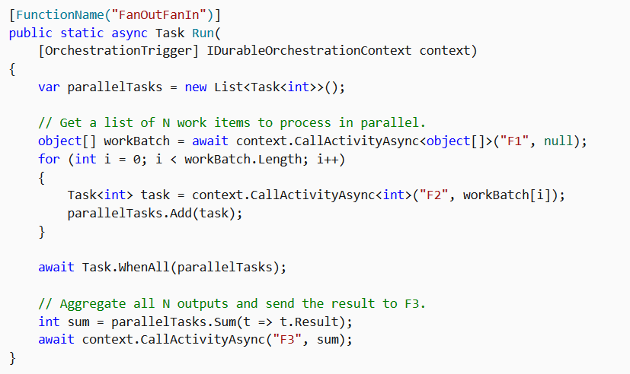
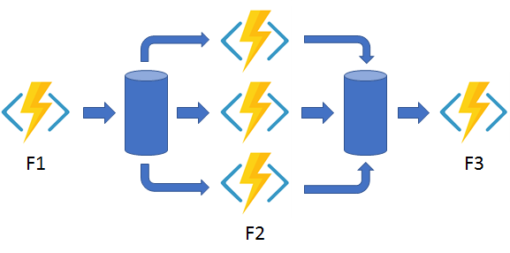
Fan out/fan in

Slide 13
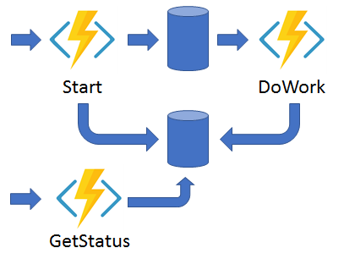
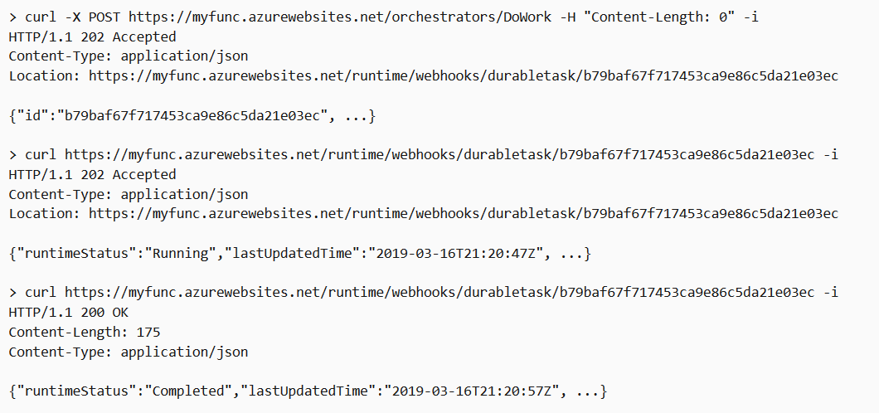
Async HTTP APIs

Slide 14
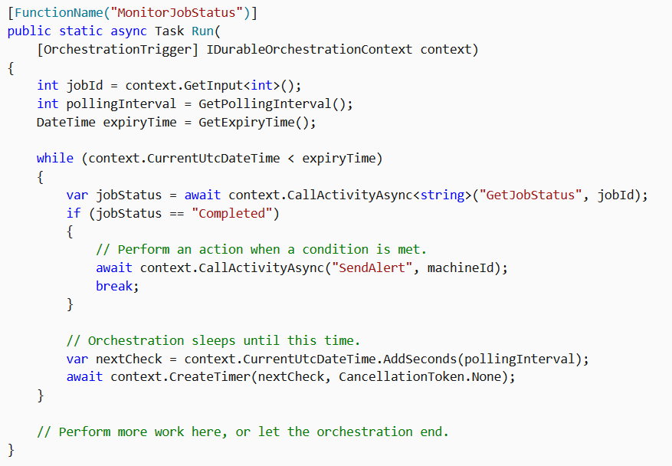
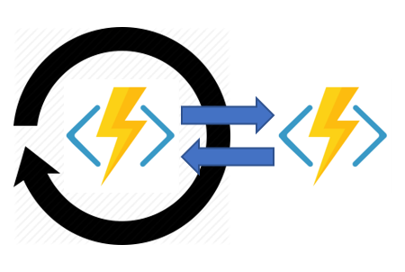
Monitor

Slide 15
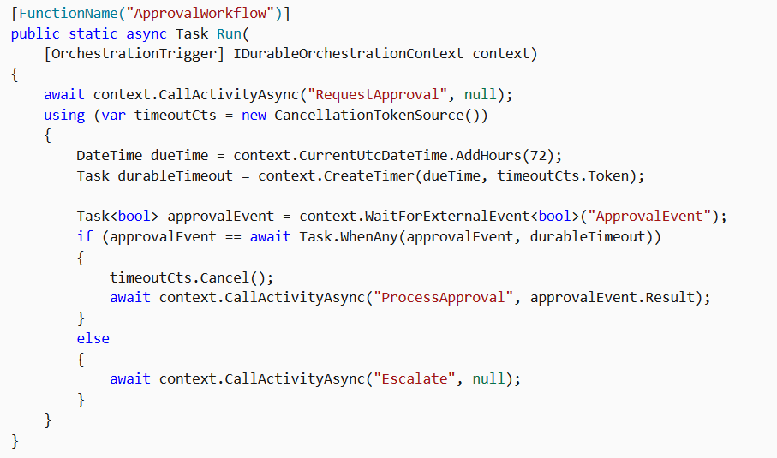
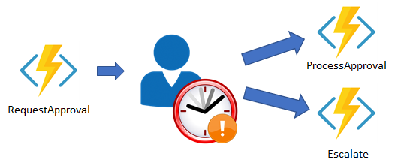
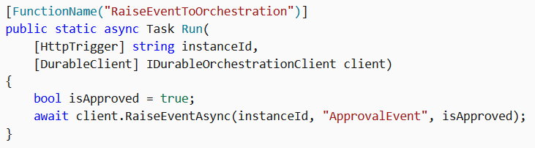
Human interaction
curl -d "true" http://localhost:7071/runtime/webhooks/durabletask/instances/{instanceId}/raiseEvent/ApprovalEvent -H "Content-Type: application/json"

Slide 16
Orchestrator function code constraints

Slide 17
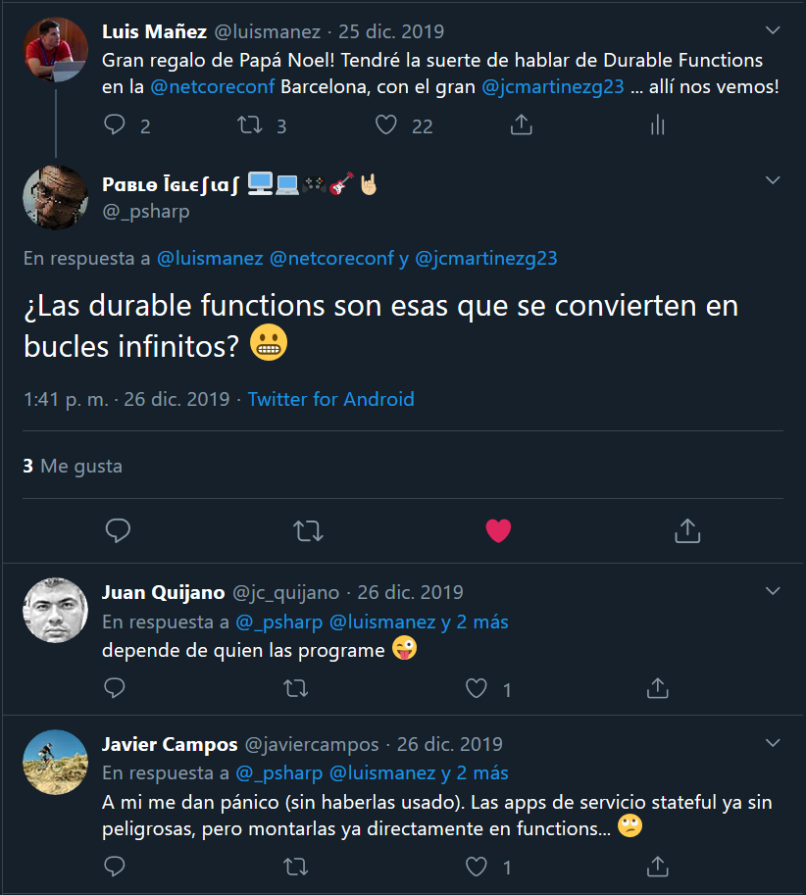

Slide 18
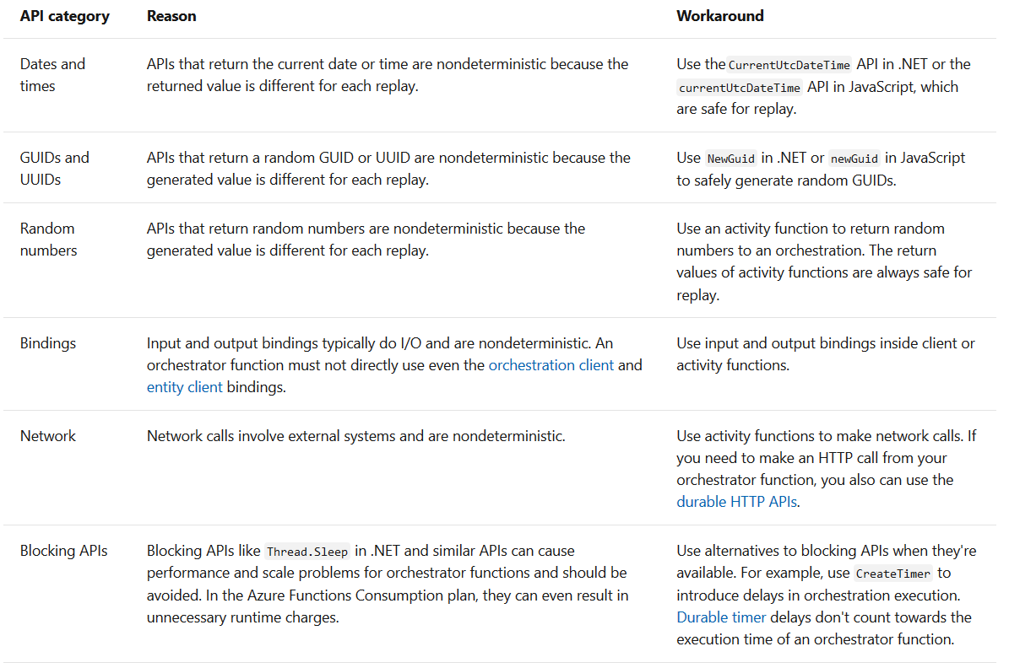
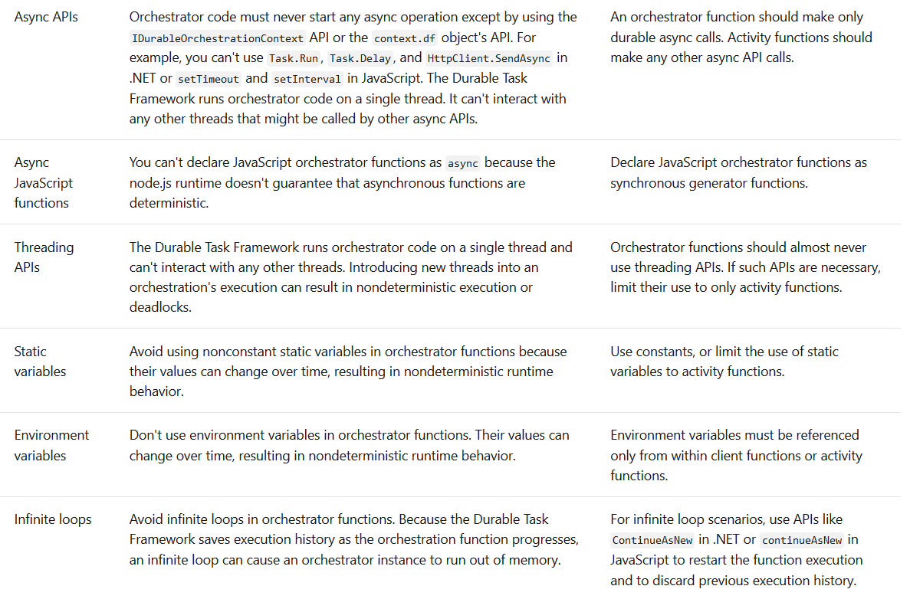
https://docs.microsoft.com/en-us/azure/azure-functions/durable/durable-functions-code-constraints

Slide 19
How this works under the hood

Slide 20
Orchestrator Lifecycle
Any await keyword yields control to the task dispatcher
The dispatcher commits any scheduled action to the storage
The dispatcher sends messages through a queue to schedule the actual work
Orchestrator effectively unloads from memory

Slide 21
Orchestrator Lifecycle
When a response is received, the orchestrator is woken up
Entire orchestration is re-executed to rebuild the current state
Every async work encountered is checked against storage to see if it’s already been executed
If it has, it retrieves the result from the table and continues execution
If it hasn’t, work is scheduled again

Slide 22
That´s cool… Can you show me some code?

Slide 23


Instayum!
Making #foodielovers since 2020

Slide 24













[BlobTrigger(“images/{name}")]
Get Image Tags
Vision API
[OrchestrationTrigger]
Index Tag
Index Tag
Index Tag
Any Tag
==
“Food”
Request Approval
Reject Notification
Resize Image
Send Notification

Slide 25
https://github.com/luismanez/netcoreconf-bcn-2020

Slide 26
Sponsors

Slide 27
Más información:
info@netcoreconf.com
@Netcoreconf
Visítanos en:
netcoreconf.com
GRACIAS

Slide 28
Appendix: Auto escalation

Slide 29
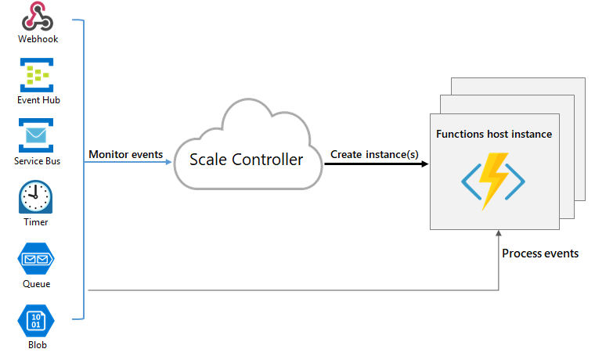
The scale controller

Slide 30
Escalation
The controller not only monitors the triggers but the internal queues
We can control the queue throughput through host.json configuration
Activity functions can be escaled out infinitely
Orchestrators can scale to as many VMs as control queues configured on host.json
Default 4, max 16

Slide 31
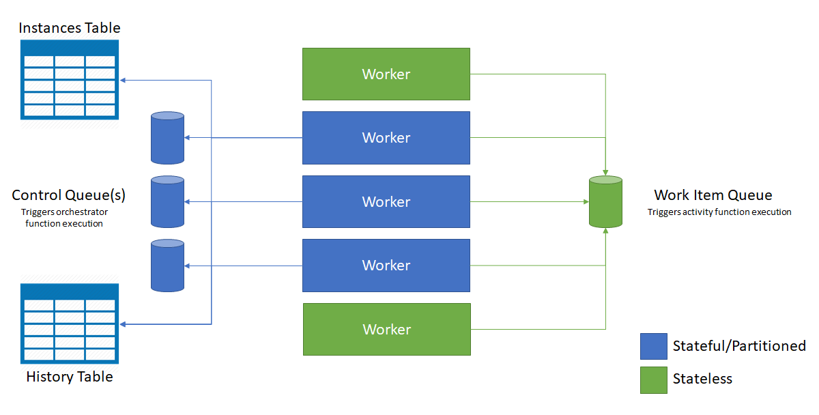
Escalation

Slide 32
Appendix: Under the hood pieces

Slide 33
The history table
Append only storage that is used by the Framework as the event store
Super useful for debugging
When inputs or outputs are too big to store on a table column, a blob is used
DO NOT depend on this

Slide 34
The instances table
Contains the status of all orchestrations
One row per instance
Eventually consistent with the history table
Inspired by CQRS pattern

Slide 35
Work-item queue
Is the one that triggers the Activity Functions
One messaged dequeued at a time
Messages contain input and info on which Activity it must execute
Only one even when the App auto scales

Slide 36
Control queues
Contain lifecycle messages (control, response and timer messages)
Composed of the payload and metadata pointing to the instance
Can dequeue as much as 32 messages with batching per instance
Messages are load balanced between control queues

Slide 37
Sponsors

Slide 38
Más información:
info@netcoreconf.com
@Netcoreconf
Visítanos en:
netcoreconf.com
GRACIAS

